Slide 1

Pro So!ution
Voting System
Created By :
S.no | ID | Name
1. | 1711981055 | Arun Saini
2. | 1711981378 | Mridul Oberoi

Slide 2
Contents
Introduction
Interfaces
Services
Tour to Full Website
How to vote ?
Team Members

Slide 3
Introduction
IN ONLINE VOTING SYSTEM A VOTER CAN USE HIS/HER VOTING RIGHT ONLINE WITHOUT ANY DIFFICULTY. HE/SHE HAS TO BE REGISTERED FIRST FOR HIM/HER TO VOTE. REGISTRATION IS MAINLY DONE BY THE SYSTEM ADMINISTRATOR FOR SECURITY REASONS. THE SYSTEM ADMINSTRATOR REGISTERS THE VOTERS ON A SPECIAL SITE OF THE SYSTEM VISITED BY HIM ONLY BY SIMPLY FILLING A REGISTRATION FORM TO REGISTER VOTER. AFTER REGISTRATION, THE VOTER IS ASSIGNED A SECRET VOTER ID WITH WHICH HE/SHE CAN USE TO LOG INTO THE SYSTEM AND ENJOY SERVICES PROVIDE BY THE SYSTEM SUCH AS VOTING. IF INVALID/WRONG DETAILS ARE SUBMITTED, THEN THE CITIZEN IS NOT REGISTERED TO VOTE.

Slide 4
Interfaces
Front End
Html
Css
Bootstrap 3 and 4
JavaScript
JQuery
Back End
PHP
AJAX
Xampp (For Server)
Mysql – For database

Slide 5
Services
Every registered one can Host Question.
Every one can vote on any specific question by just putting its Generated Key.
Every user will have his/her Profile , where they can edit their Information or can update information.
You can send feedback regarding the difficulties / bug facing .

Slide 6
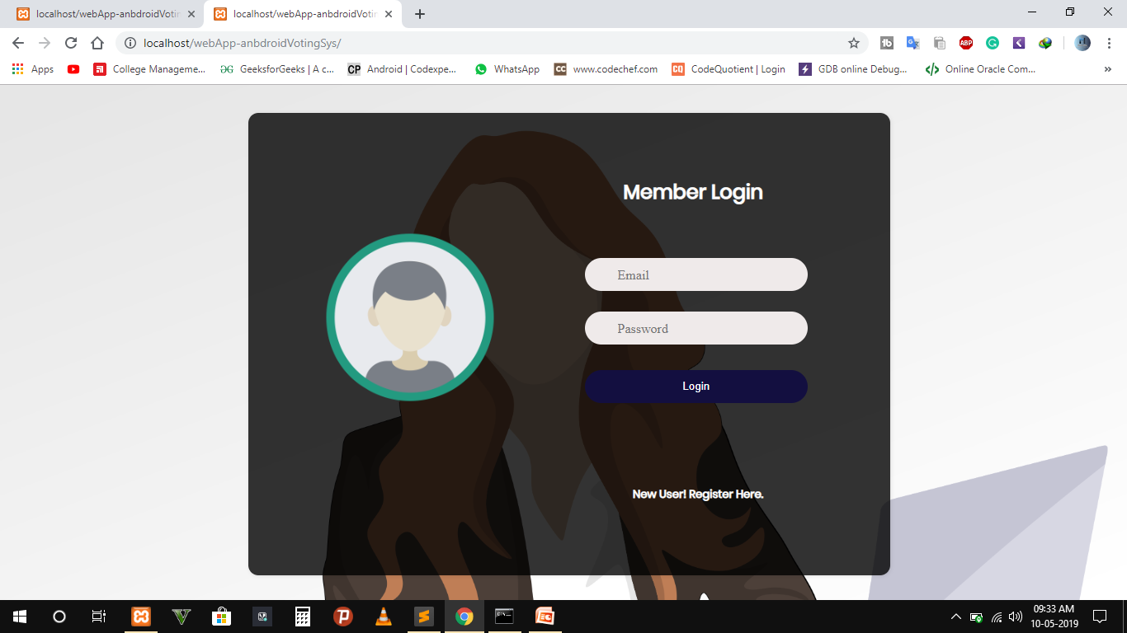
My Website
Login page.

Slide 7
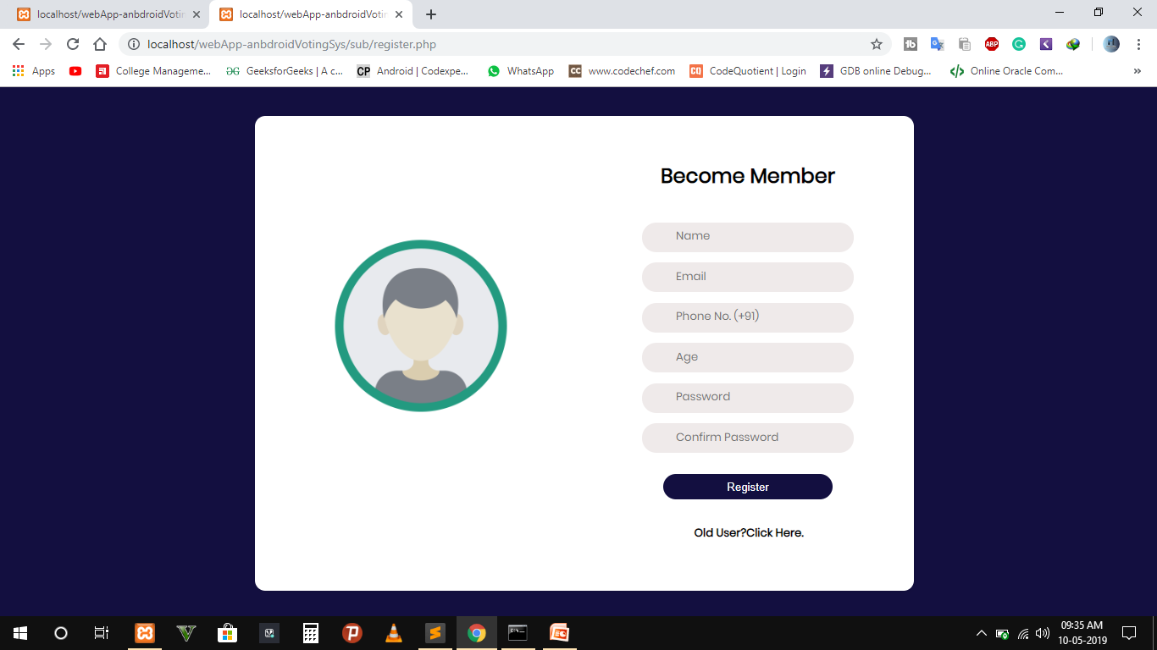
2. Become a member. (Register page).

Slide 8
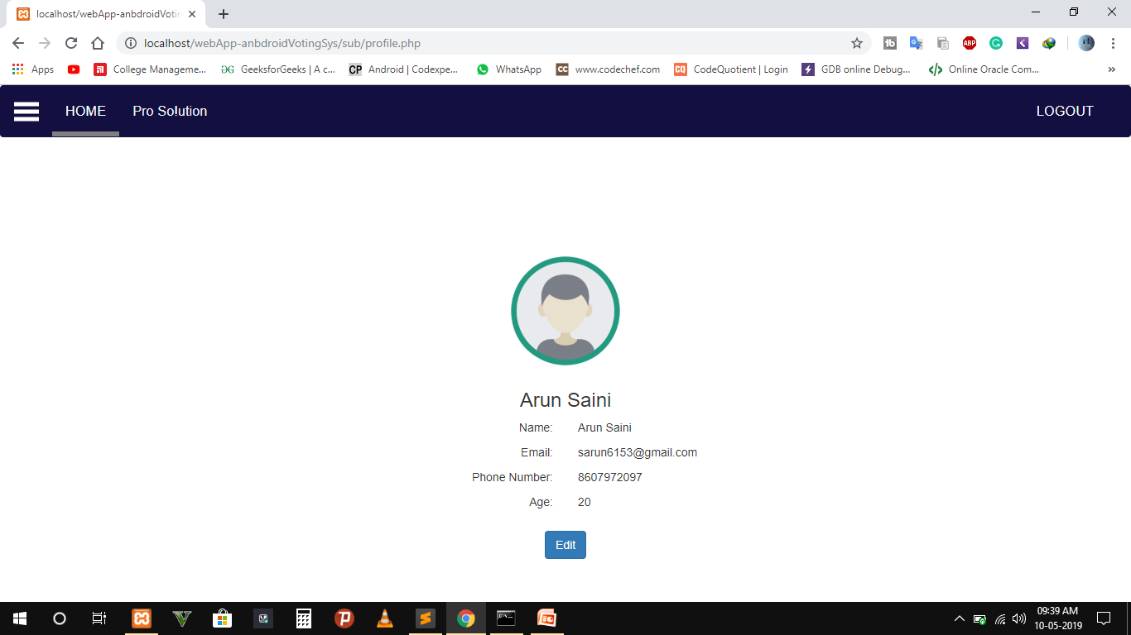
3. Profile Tab page of our website , where user can see details and edit it.

Slide 9
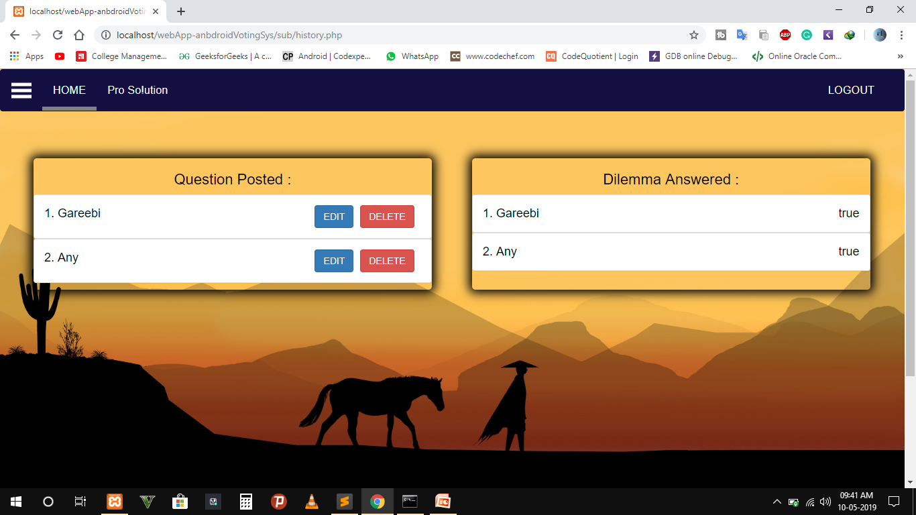
4. Activity Tab ,Here you can see all the Activities performed , Like hosting question and answering a question .

Slide 10
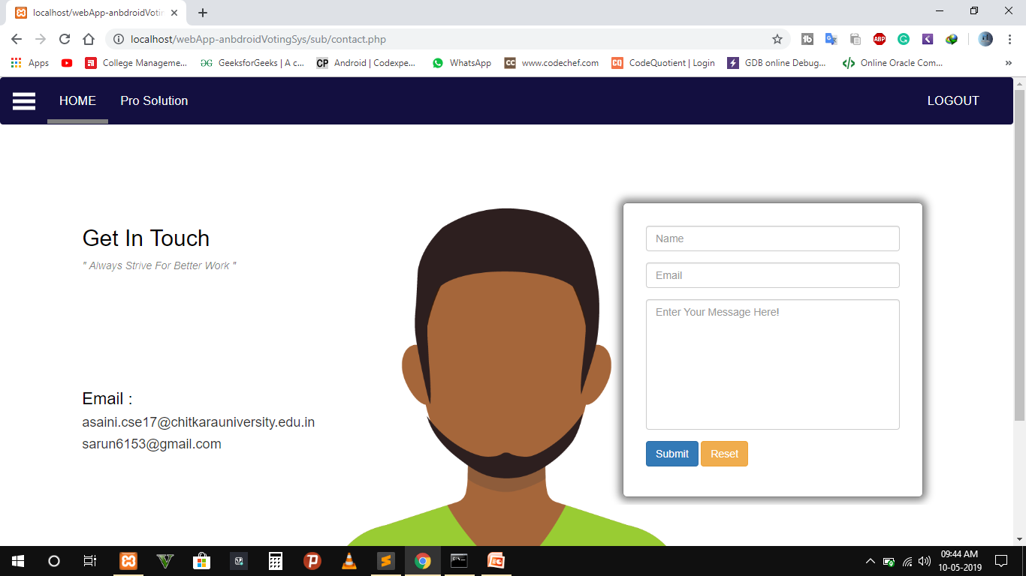
5. You can give feedback in Contact tab.

Slide 11
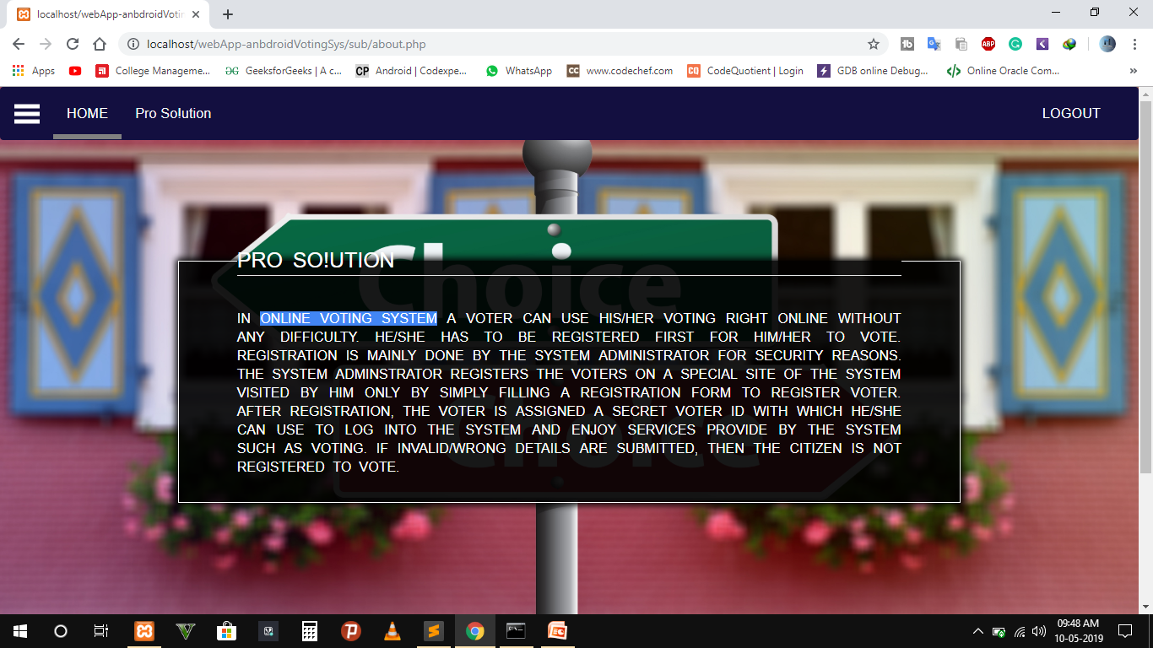
6. About tab , this tab has description about the website.

Slide 12
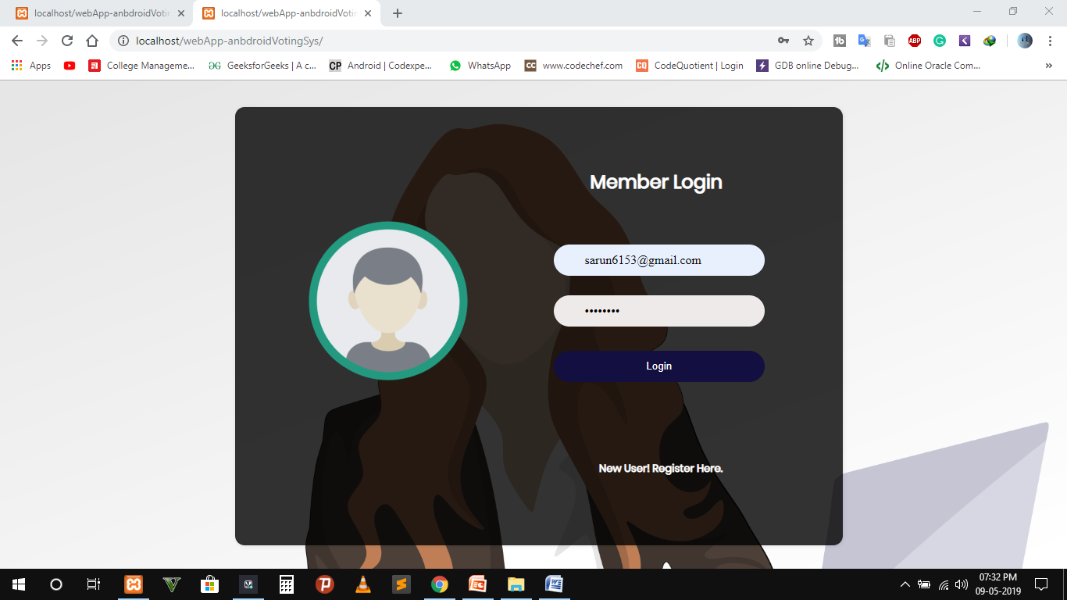
How to Vote ?
First Login to the website.

Slide 13
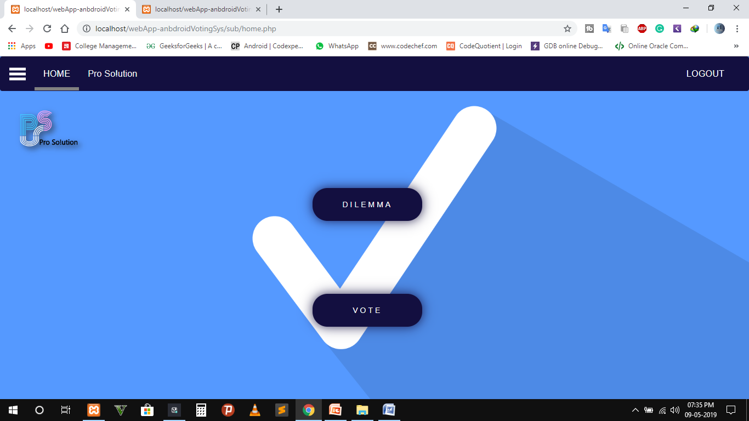
2. Click Dilemma to Host question.

Slide 14
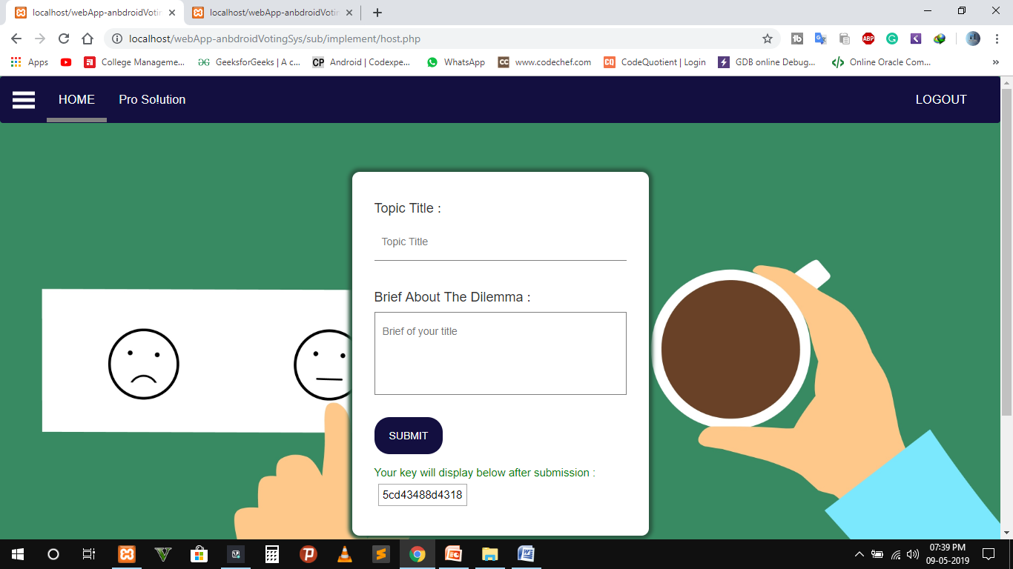
3. After filling form Click on Submit then it will generate a unique key.

Slide 15
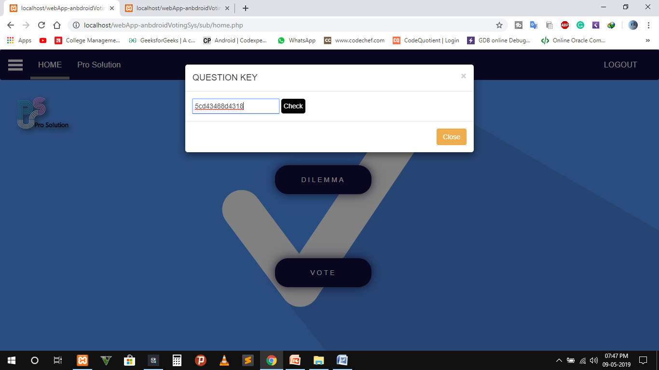
4. Now come to the Home page and click on the voter button , and enter the Question key then submit.

Slide 16
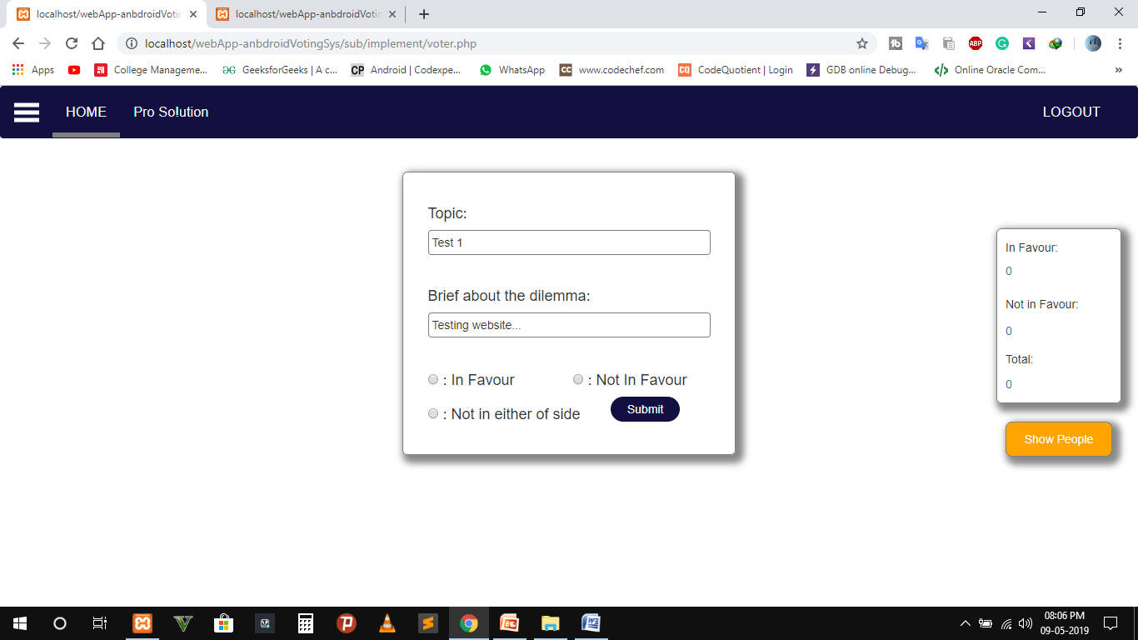
5. After getting key checked , it redirects to the following page where you can respond in the following manner . And your vote will get submit here.

Slide 17

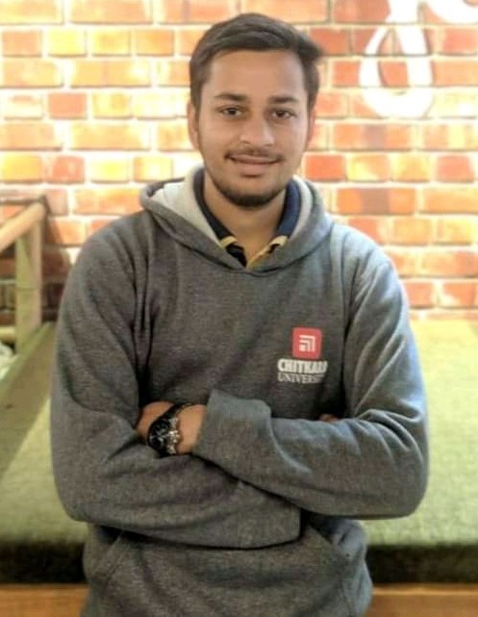
DUO
Arun Saini
Mridul Oberoi

